Slide 1


Slide 2
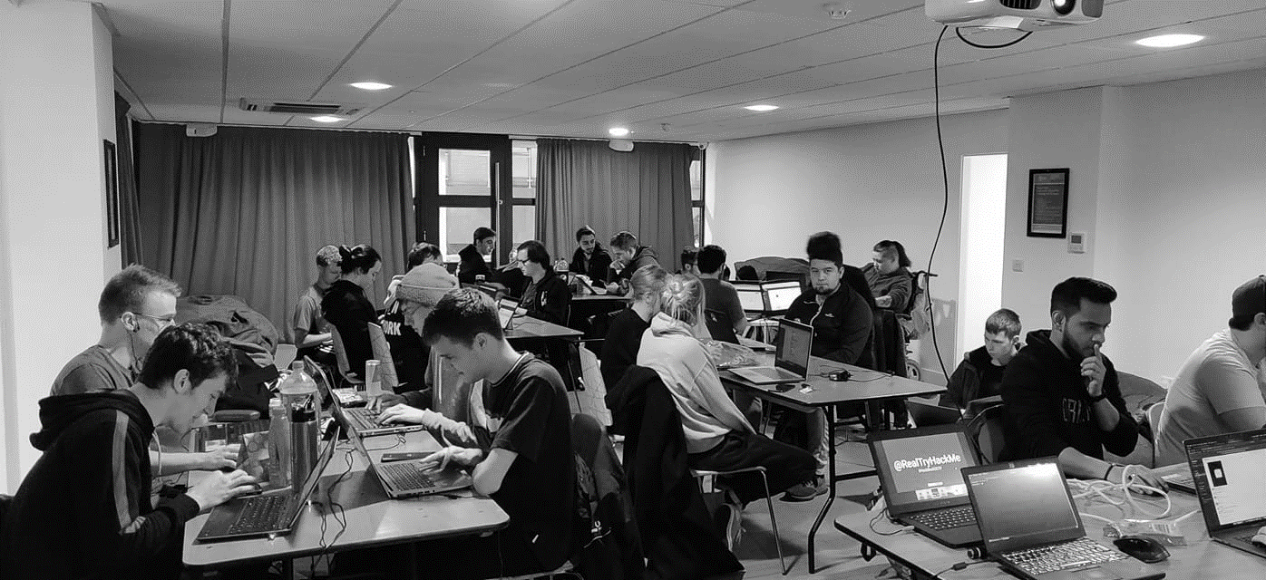



/dmuhackers
@dmuhackers
The Windows Talk

Slide 3




Disclaimer
Don’t do illegal shit without permission from Her Majesty

Slide 4
Overview
Announcements??
Windows – Why do we care?
How are Windows networks organised? Workgroups vs. Domains
AD Forests
Security Issues
User Accounts and Computer Accounts
Kerberoasting example (w/ practical)

Slide 5
Practical
PREP: Go to the Attacktive Directory room on TryHackMe. These tools should be installed in the AttackBox
Impacket:
$ sudo apt install golang
$ export GOROOT=/usr/lib/go
$ export GOPATH=$HOME/go
$ export PATH=$GOPATH/bin:$PATH
$ sudo git clone https://github.com/SecureAuthCorp/impacket.git /opt/impacket
$ pip3 install -r /opt/impacket/requirements.txt
$ python3 ./setup.py install
Kerbrute:
$ sudo git clone https://github.com/ropnop/kerbrute /opt/kerbrute
$ cd /opt/kerbrute
$ sudo make linux
$ cd dist/

Slide 6
Windows 101 – Why?
Most prolific OS in existence
Basically every business uses it
Is old and patched together – therefore lots of attack surface
Is unavoidable if you work in IT or Cyber, but (annoyingly) isn’t covered much at uni

Slide 7
Windows Networks 101
Most Windows machines you come across will be part of a larger domain.
This consists of a group of Windows workstations and other servers (e.g. update server – WSUS) all connected to a DC – Domain Controller
Domain Controllers run Active Directory Domain Services (AD DS).
Works like a phone/address book for the domain, containing user and computer information, security groups, applicable group policy configurations, etc.
Stored at: C:\Windows\System32\NTDS.DIT
Ahem. Very sus

Slide 8
WORKGROUPS
Windows networks come in two flavours:
WORKGROUP – a “local” Windows network that operates peer-to-peer (no domain controller) – think of a room of computers connected into a LAN.
Computers operate independently, so can host their own file shares and resources such as printers
Good for small orgs (<5 machines), but quickly become a nightmare to manage and configure due to no central control.
Have to manually replicate all settings changes across all member devices

Slide 9

Domains
Can consist of a single domain controller (Windows server running AD) by itself, or a group of computers and different servers in the same network
Admins can make changes remotely via Group Policy
You can change almost any Windows setting via Group Policy
Group Policy is a frontend to the Windows Registry, which is where settings values are stored
Workstations contact the domain controller to receive Group Policy updates (normally every 90 minutes, but running gpupdate /force will request a Group Policy update immediately)
Domains can also have subdomains for different areas of the business, e.g. root domain: dmuhackers.local, subdomain: ctfclub.hackers.local would have its own DC. This would then be called a forest

Slide 10
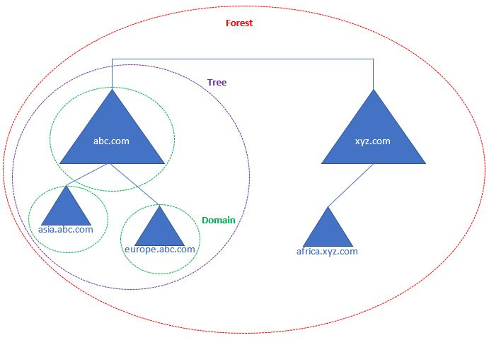
AD Forests
Root Domain: abc.com
Subdomain: asia.abc.com
DC name: dc01.asia.abc.com

Slide 11
Security Issues
One of the main security problems with DCs is that they can run multiple roles (e.g. AD DS, WSUS, Print Server, File Shares) concurrently, on the same system.
What problems might this cause? Hint: it was a nightmare to deal with
https://msrc.microsoft.com/update-guide/vulnerability/CVE-2021-34527
- Allows any unauthenticated user to execute commands as SYSTEM (windows root) on a Domain Controller running the print spooler service

Slide 12
Active Directory
All Windows domains are made up of:
Users
Computers
User Accounts: Operate in a user context
(e.g. John’s user account can access the HR file share)
Computer Accounts: Operate in computer context
(e.g. Computer WS-69.dmuhackers.local is allowed to send traffic through the proxy server between 9am and 5pm)
Important to note that different GP settings apply to different account
types

Slide 13
So… Am I looking at a DC?
DCs commonly have these ports open:
53 – DNS: As Domain Controllers act as DNS servers for the domain they’re in
88 – Kerberos: Used to authenticate users logging into the domain
135 – NetBIOS – Allows applications to establish sessions with shared resources
139 – SMB – Used for transferring files over a Windows network, among other things <– (samba is the open-source sister implementation)
3268 – LDAP – Lightweight Directory Access Protocol – used to query AD remotely
3389 – RDP – Remote Desktop. Can get useful info from the SSL certificate

Slide 14
Poking a Windows DC
Live Demo – AttacktiveDirectory @ TryHackMe
Steps:
1. Nmap
2. Trying to find valid user accounts
3. Cracking hashes with Hashcat
4. Enumerating shares on the box with smbclient
5. Using Impacket to dump server secrets
6. Evil-WinRM to abuse admin access

Slide 15
BUY OUR SHIT
Buy now from the SU site which is … err… still down…?:
https://www.demontfortsu.com/soc/DMUHackers/ > More

